Slide 1
Parquet vs. Delta Lake
Efficient Data Storage for Microsoft Fabric
Edward Pollack
Microsoft Data Platform MVP

Slide 2

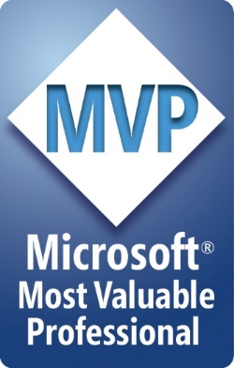





Ed Pollack
Microsoft Data Platform MVP
Published author of:
Dynamic SQL: Applications, Performance, and Security, 2nd Edition
Analytics Optimization with Columnstore Indexes in SQL Server
Published in Expert T-SQL Functions in SQL Server, 3rd Edition
Expert Performance Indexing in SQL Server, 4th Edition
Author on Simple Talk.
Organizes:
SQL Saturday New York City
SQL Saturday Albany 2024
Future Data Driven
Capital Area SQL Server User Group
Speaker at many data events
Find me on: LinkedIn

Slide 3
The Parquet File Format
Open file format
Portable, no vendor lock-in!
Compressed columnar storage
Far more efficient for analytics than other formats
CSV, JSON, XML, etc…

Slide 4
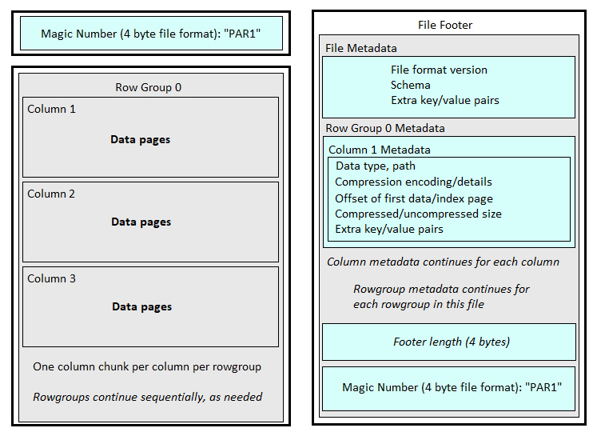
Parquet File Overview
Rows are divided into
row groups
Each column’s data
per rowgroup
is a Column chunk
Data pages store data
within each column chunk

Slide 5
Metadata
Rowgroup metadata is stored in the file footer.
Contains row counts, size, and page offset info
The page header stores column metadata for its contents
Min, max, data type, encoding detail
Allows readers to know file contents without reading data.

Slide 6
Compression
Parquet has many built-in encoding methods:
Run-length encoding
Dictionary encoding
Bit-packing
Delta encoding
Delta string encoding
Can adjust compression algorithm
Snappy, gzip, lz4, etc…

Slide 7
Predicate Pushdown
Query engines push filters directly to the storage layer.
Can skip reading unneeded parquet file data.
Can skip unneeded column chunks.
Benefits from sorted data.

Slide 8
The Delta Lake Format
Open file format
Portable, no vendor lock-in!
Versioned parquet files with transaction log.
Provides:
ACID
Time travel
Concurrent writes
Versioning

Slide 9
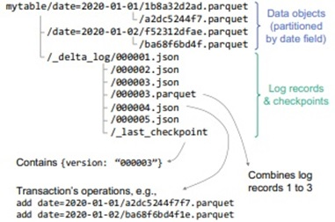
The Delta Lake Format

Slide 10
Delta Lake Basic Architecture
Deletes accomplished via deletion vectors
Soft-delete process
Optimized writes
Combines trickle-load inserts into one thread
Data is asynchronously inserted in batches
Improves insert performance
Features are version-dependant

Slide 11
Delta Lake Maintenance
OPTIMIZE
Removes deletion vectors and rewrites parquet files.
Combines undersized parquet files.
VACCUUM
Applies retention period to transaction log files.
Removes time travel data older than retention period.
Can redefine retention period/time travel range.

Slide 12
Delta Lake Features
OPTIMIZE
Removes deletion vectors and rewrites parquet files.
Combines undersized parquet files.
VACCUUM
Applies retention period to transaction log files.
Removes time travel data older than retention period.
Can redefine retention period/time travel range.

Slide 13
Optimization
V-Order Optimization
Reorders rows within rowgroups to improve compression.
Z-Order Optimization
Multi-dimensional clustering
Analogous to non-clustered indexes in SQL
Liquid Clustering
Co-located multi-dimensional clustering
Provides persisted indexed dimensions

Slide 14
Parquet vs. Delta Lake
Parquet is ideal for:
Full or infrequent data loads
Concurrency is not a problem.
Time travel/versioning is not needed.
Infrequent updates.
Delta Lake is ideal for:
ACID transaction support.
Time travel/versioning.
Frequent incremental data loads and/or streaming data.
Expected contention between readers & writers.
More frequent updates.
Parquet files can be migrated to Delta Lake format and vice-versa.

Slide 15
Conclusion
Parquet and Delta Lake are the underlying storage formats for many popular analytic engines.
Parquet provides highly compressed storage format with modern metadata management / performance features.
Delta Lake provides write capabilities with time travel, versioning, and ACID transactions.
Learn more?

Slide 16
Thank You!
Find me here:
ed@edwardpollack.com
Ed Pollack | LinkedIn
Find my content here:
EdwardPollack (Ed Pollack) (github.com)
Edward Pollack, Author at Simple Talk (red-gate.com)
Ed Pollack, Author at SQL Shack - articles about database auditing, server performance, data recovery, and more

